Slide 1
Suicide and Self-Harm Data
February 2021

Slide 2
Purpose
These slides are intended to be used in presentations when referencing state data
Slides can be reformatted to match the style of your presentation

Slide 3
Contents
Analytic Notes, slides 4-8
Suicide: Trends Over Time, slides 10-11
Suicide and Self-Harm: Geographic Areas, slides 13-16
Suicide and Self-harm: Demographics, slides 18-27
Suicide Risk Factors, slides 29-48

Slide 4
Analytic Notes

Slide 5
Analytic Notes
All data was obtained from the Wisconsin Interactive Statistics on Health (WISH) tool: https://www.dhs.wisconsin.gov/wish/index.htm
Suicide data was obtained from: https://www.dhs.wisconsin.gov/wish/injury-mortality/icd10-form.htm and https://www.dhs.wisconsin.gov/wish/violent-death/index.htm
Self-harm data was obtained from: https://www.dhs.wisconsin.gov/wish/injury-ed/query.htm and https://www.dhs.wisconsin.gov/wish/injury-hosp/query.htm

Slide 6
Analytic Notes: Suicide Data
1. All data shown includes Wisconsin residents only (unless otherwise noted).
2. Data shown from the injury mortality WISH module includes all Wisconsin resident deaths.
3. Data shown from the Wisconsin Violent Death Reporting System (WVDRS) WISH module does not include Wisconsin residents who were injured or died outside of Wisconsin.
4. The injury mortality and WVDRS WISH modules represents unique individuals, meaning an individual is represented only once in the data.

Slide 7
Analytic Notes: Self-Harm Data
1. Hospitalizations and emergency department WISH modules represent hospital and emergency department discharges and not unique individuals, i.e., an individual could be represented multiple times if they were discharged from a hospital or emergency department more than once.
3. The coding system changed from the 9th Revision of the ICD to the 10th Revision in October 2015 and self-harm injury data prior to 2016 is not comparable.

Slide 8
Analytic Notes: Other
1. Geographic variables are based on patient’s or decedent’s place of residence.
2. WVDRS circumstance data are limited to cases in which circumstances were reported.

Slide 9
Suicide: Trends Over Time

Slide 10
Suicide rate among Wisconsin residents increased by 28%, 2000-2019.
Data sources: Wisconsin Dept. of Health Services, Division of Public Health, Office of Health Informatics. Wisconsin Interactive Statistics on Health (WISH) data query system, https://www.dhs.wisconsin.gov/wish/index.htm, Injury-Related Mortality Module, accessed 2/10/2021.Mortality data from the National Vital Statistics System (NVSS), 2000–2019, retrieved from: https://wonder.cdc.gov/Deaths-by-Underlying-Cause.html. Accessed: January 2021.

Slide 11
Suicide rate increased among males by 25% and among females by 37%, 2000-2019.
Data source: Wisconsin Dept. of Health Services, Division of Public Health, Office of Health Informatics. Wisconsin Interactive Statistics on Health (WISH) data query system, https://www.dhs.wisconsin.gov/wish/index.htm, Injury-Related Mortality Module, accessed 2/10/2021.

Slide 12
Suicide and Self-Harm: Geographic Areas

Slide 13
The Wisconsin suicide rate ranks 3rd highest in the Midwest region, 2015-2019.
Age-adjusted suicide rates per 100,000
13.6
14.7
14.1
15.1
10.9
15.3
14.6
Data sources: Centers for Disease Control and Prevention, National Center for Health Statistics. Underlying Cause of Death 2015–201 on CDC WONDER Online Database, released December, 2020 (Wisconsin, Minnesota, Iowa, Illinois, Indiana, Ohio, and Michigan data).

Slide 14
Suicide rates were significantly higher in dark red counties when compared to the state, 2015-2019.
Age-adjusted suicide rates per 100,000
Significantly higher than state rate
Higher than state rate
Lower than state rate
Significantly lower than state rate
No rate calculated (<5 suicides)
Data source: Wisconsin Dept. of Health Services, Division of Public Health, Office of Health Informatics. Wisconsin Interactive Statistics on Health (WISH) data query system, https://www.dhs.wisconsin.gov/wish/index.htm, Injury-Related Mortality Module, accessed 2/10/2021.

Slide 15
Suicide rate in rural counties was higher than urban counties, 2015-2019.
Age-adjusted suicide rates per 100,000
Rural Counties: 16.5/100,000
Urban: 14.1/100,000
Data source: Wisconsin Dept. of Health Services, Division of Public Health, Office of Health Informatics. Wisconsin Interactive Statistics on Health (WISH) data query system, https://www.dhs.wisconsin.gov/wish/index.htm, Injury-Related Mortality Module, accessed 2/10/2021.

Slide 16
Self-harm emergency department rate among rural counties was higher than urban counties, 2016-2019.
Rural Counties: 77.1/100,000
Urban: 68.1/100,000
Data source: Wisconsin Dept. of Health Services, Division of Public Health, Office of Health Informatics. Wisconsin Interactive Statistics on Health (WISH) data query system, https://www.dhs.wisconsin.gov/wish/index.htm, Injury-Related Emergency Department Visits Module, accessed 2/10/2021.

Slide 17
Suicide and Self-Harm: Demographics

Slide 18
The majority of suicide deaths were male, 2015-2019.
Data source: Wisconsin Dept. of Health Services, Division of Public Health, Office of Health Informatics. Wisconsin Interactive Statistics on Health (WISH) data query system, https://www.dhs.wisconsin.gov/wish/index.htm, Injury-Related Mortality Module, accessed 2/10/2021.

Slide 19
The majority of hospitalizations with self-harm injuries were female, 2016-2019.
Data source: Wisconsin Dept. of Health Services, Division of Public Health, Office of Health Informatics. Wisconsin Interactive Statistics on Health (WISH) data query system, https://www.dhs.wisconsin.gov/wish/index.htm, Injury-Related Hospitalizations Module, accessed 2/10/2021.

Slide 20
The majority of emergency department visits with self-harm injuries were female, 2016-2019.
Data source: Wisconsin Dept. of Health Services, Division of Public Health, Office of Health Informatics. Wisconsin Interactive Statistics on Health (WISH) data query system, https://www.dhs.wisconsin.gov/wish/index.htm, Injury-Related Emergency Department Visits Module, accessed 2/10/2021.

Slide 21
Suicide rate was highest among females ages 45-54 and males ages 75 and older, 2015-2019.
Data source: Wisconsin Dept. of Health Services, Division of Public Health, Office of Health Informatics. Wisconsin Interactive Statistics on Health (WISH) data query system, https://www.dhs.wisconsin.gov/wish/index.htm, Injury-Related Mortality Module, accessed 2/10/2021.

Slide 22
The rate of hospitalization with self-harm injuries for females, ages 15 to 17, was more than three times higher compared to males, 2016-2019.
Data source: Wisconsin Dept. of Health Services, Division of Public Health, Office of Health Informatics. Wisconsin Interactive Statistics on Health (WISH) data query system, https://www.dhs.wisconsin.gov/wish/index.htm, Injury-Related Hospitalizations Module, accessed 2/11/2021.

Slide 23
The rate of emergency (ED) visits with self-harm injuries for females, ages 15-17, was more than three times higher compared to males, 2016-2019.
Data source: Wisconsin Dept. of Health Services, Division of Public Health, Office of Health Informatics. Wisconsin Interactive Statistics on Health (WISH) data query system, https://www.dhs.wisconsin.gov/wish/index.htm, Injury-Related Emergency Department Visits Module, accessed 2/11/2021.

Slide 24
Suicide rate was higher among Whites and American Indians/Alaska Natives compared to Asians and Blacks, 2015–2019.
Data source: Wisconsin Dept. of Health Services, Division of Public Health, Office of Health Informatics. Wisconsin Interactive Statistics on Health (WISH) data query system, https://www.dhs.wisconsin.gov/wish/index.htm, Injury-Related Mortality Module, accessed 2/11/2021.

Slide 25
Hospitalization and emergency department visit rates with self-harm injuries were highest among American Indians/Alaska Natives and Blacks, 2016-2019.
Data source: Wisconsin Dept. of Health Services, Division of Public Health, Office of Health Informatics. Wisconsin Interactive Statistics on Health (WISH) data query system, https://www.dhs.wisconsin.gov/wish/index.htm, Injury-Related Emergency Department Visits Module, accessed 2/11/2021.

Slide 26
Suicide rate was higher among Non-Hispanics compared to Hispanics, 2015-2019.
Non-Hispanic
Hispanic
Data source: Wisconsin Dept. of Health Services, Division of Public Health, Office of Health Informatics. Wisconsin Interactive Statistics on Health (WISH) data query system, https://www.dhs.wisconsin.gov/wish/index.htm, Injury-Related Mortality Module, accessed 2/11/2021.

Slide 27
Hospitalization and emergency department visit rates with self-harm injuries were higher among non-Hispanics compared to Hispanics, 2016-2019.
Emergency department visit rate
Hospitalization rate
Data source: Wisconsin Dept. of Health Services, Division of Public Health, Office of Health Informatics. Wisconsin Interactive Statistics on Health (WISH) data query system, https://www.dhs.wisconsin.gov/wish/index.htm, Injury-Related Emergency Department Visits Module, accessed 2/11/2021.

Slide 28
Risk and Protective Factors

Slide 29
Method of Suicide

Slide 30
Firearm was the most commonly used method of suicide, 2015-2019.
Data source: Wisconsin Dept. of Health Services, Division of Public Health, Office of Health Informatics. Wisconsin Interactive Statistics on Health (WISH) data query system, https://www.dhs.wisconsin.gov/wish/index.htm, Injury-Related Mortality Module, accessed 2/12/2021.

Slide 31
Males were more likely than females to use firearms or suffocation as method of suicide, 2015-2019.
Data source: Wisconsin Dept. of Health Services, Division of Public Health, Office of Health Informatics. Wisconsin Interactive Statistics on Health (WISH) data query system, https://www.dhs.wisconsin.gov/wish/index.htm, Injury-Related Mortality Module, accessed 2/12/2021.

Slide 32
Suffocation was the most common method of suicide for those 10 to 17. Firearm was the most common method of suicide for those 18 and older, 2015-2019.
Data source: Wisconsin Dept. of Health Services, Division of Public Health, Office of Health Informatics. Wisconsin Interactive Statistics on Health (WISH) data query system, https://www.dhs.wisconsin.gov/wish/index.htm, Injury-Related Mortality Module, accessed 2/12/2021.

Slide 33
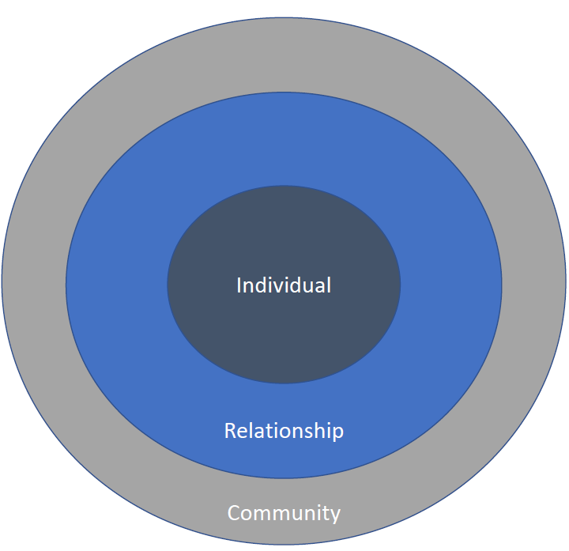
Social Ecological Model
Individual: biological and personal history that increase the likelihood of becoming a victim or perpetrator of violence.
Relationship: close or significant relationships that may increase the risk of experiencing violence as a victim or perpetrator
Community: settings, such as schools, workplaces, and neighborhoods, in which social relationships occur and the characteristics of these associated with becoming victims or perpetrators of violence.
Societal: broad societal factors that help create a climate in which violence is encouraged or inhibited (not displayed in graphic).

Slide 34
Individual

Slide 35
Less than half of suicides left a suicide note, disclosed their intent, or had a history of suicide attempts, 2014-2018.
Data source: Wisconsin Dept. of Health Services, Division of Public Health, Office of Health Informatics. Wisconsin Interactive Statistics on Health (WISH) data query system, https://www.dhs.wisconsin.gov/wish/index.htm, Wisconsin Violent Deaths Reporting System Module, accessed 2/12/2021.

Slide 36
Females who died by suicide were more likely to have a history of suicide attempts compared to males, 2014-2018.
Data source: Wisconsin Dept. of Health Services, Division of Public Health, Office of Health Informatics. Wisconsin Interactive Statistics on Health (WISH) data query system, https://www.dhs.wisconsin.gov/wish/index.htm, Wisconsin Violent Deaths Reporting System Module, accessed 2/12/2021.

Slide 37
The most commonly reported circumstances among suicide deaths were feeling depressed, having a mental health issue, and having a history for mental health or substance use issues, 2014-2018.
Data source: Wisconsin Dept. of Health Services, Division of Public Health, Office of Health Informatics. Wisconsin Interactive Statistics on Health (WISH) data query system, https://www.dhs.wisconsin.gov/wish/index.htm, Wisconsin Violent Deaths Reporting System Module, accessed 2/12/2021.

Slide 38
Females who died by suicide were more likely to have had a known mental health issue, been receiving treatment for mental health or substance use at the time of death, and a history of treatment for mental health or substance use compared with males, 2014-2018.
Data source: Wisconsin Dept. of Health Services, Division of Public Health, Office of Health Informatics. Wisconsin Interactive Statistics on Health (WISH) data query system, https://www.dhs.wisconsin.gov/wish/index.htm, Wisconsin Violent Deaths Reporting System Module, accessed 2/12/2021.

Slide 39
Approximately 1 in every 4 people who died by suicide had a reported alcohol issue, 2014-2018.
Data source: Wisconsin Dept. of Health Services, Division of Public Health, Office of Health Informatics. Wisconsin Interactive Statistics on Health (WISH) data query system, https://www.dhs.wisconsin.gov/wish/index.htm, Wisconsin Violent Deaths Reporting System Module, accessed 2/12/2021.

Slide 40
Females who died by suicide were more likely to have a non-alcohol substance use issue reported compared with males, 2014-2018.
Data source: Wisconsin Dept. of Health Services, Division of Public Health, Office of Health Informatics. Wisconsin Interactive Statistics on Health (WISH) data query system, https://www.dhs.wisconsin.gov/wish/index.htm, Wisconsin Violent Deaths Reporting System Module, accessed 2/12/2021.

Slide 41
Approximately 1 in every 4 people who died by suicide had a reported physical health problem that contributed to the suicide, 2014-2018.
Data source: Wisconsin Dept. of Health Services, Division of Public Health, Office of Health Informatics. Wisconsin Interactive Statistics on Health (WISH) data query system, https://www.dhs.wisconsin.gov/wish/index.htm, Wisconsin Violent Deaths Reporting System Module, accessed 2/12/2021.

Slide 42
Of people who died by suicide, approximately 1 in every 5 had a reported job problem, and approximately 1 in every 5 had a reported financial problem, 2014-2018.
Data source: Wisconsin Dept. of Health Services, Division of Public Health, Office of Health Informatics. Wisconsin Interactive Statistics on Health (WISH) data query system, https://www.dhs.wisconsin.gov/wish/index.htm, Wisconsin Violent Deaths Reporting System Module, accessed 2/12/2021.

Slide 43
Males who died by suicide were more likely than females to have job, financial, or legal problems reported, 2014-2018.
Data source: Wisconsin Dept. of Health Services, Division of Public Health, Office of Health Informatics. Wisconsin Interactive Statistics on Health (WISH) data query system, https://www.dhs.wisconsin.gov/wish/index.htm, Wisconsin Violent Deaths Reporting System Module, accessed 2/12/2021.

Slide 44
Relationship

Slide 45
More than 1 in every 3 people who died by suicide had a reported intimate partner issue, 2014-2018.
Data source: Wisconsin Dept. of Health Services, Division of Public Health, Office of Health Informatics. Wisconsin Interactive Statistics on Health (WISH) data query system, https://www.dhs.wisconsin.gov/wish/index.htm, Wisconsin Violent Deaths Reporting System Module, accessed 2/12/2021.

Slide 46
Nearly 1 in every 5 suicide deaths occurred after a recent argument or conflict, 2014-2018.
Data source: Wisconsin Dept. of Health Services, Division of Public Health, Office of Health Informatics. Wisconsin Interactive Statistics on Health (WISH) data query system, https://www.dhs.wisconsin.gov/wish/index.htm, Wisconsin Violent Deaths Reporting System Module, accessed 2/12/2021.

Slide 47
Community

Slide 48
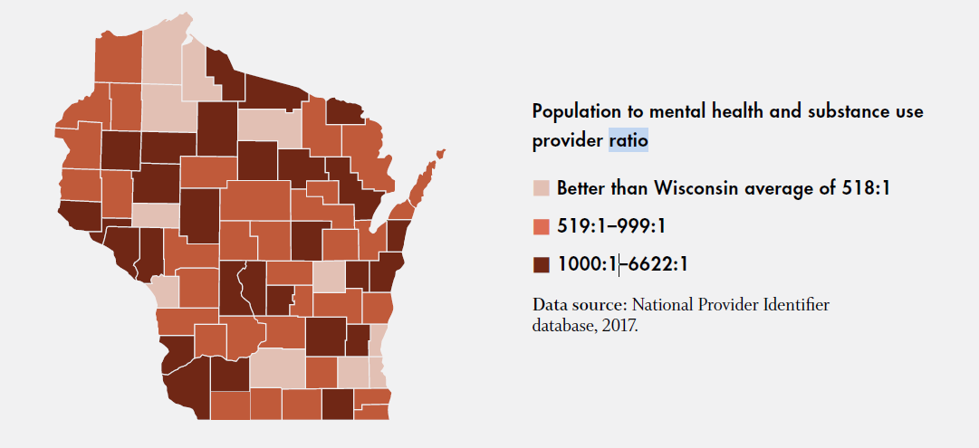
Counties shown in dark red have the lowest availability of mental health and substance use providers, 2017.

