Slide 1
MHA of WI Suicide Care Trainings
Zero Suicide Topic Call
April 1, 2020
12:00pm to 1:00pm

Slide 2
De-Escalation and Coping Skills to Prevent and Manage Crisis Situations
May 19, 2020
9:00am - 4:00pm
Chula Vista Resort, 1000 Chula Vista Pkwy Wisconsin Dells, WI 53965
Developing coping methods for the consumer in crisis and those who care for them is an important part of crisis intervention. Skills such as mindfulness, emotional regulation and distress tolerance can be very helpful for persons who are struggling to cope. Crisis Responders will learn skills informed by both Dialectical Behavioral Therapy (DBT) and Motivational Interviewing (MI), and will gain more tools to add to their crisis intervention toolbox. (6.0 Continuing Education Hours)
Learning Objectives:
  Learn how we regulate stress
  Review of principles of crisis intervention
  Learn skills that are effective to prevent and manage crises
  Practice teaching consumers how to use these skills
  Trainer:
  Jessica Beauchamp, LCSW, SAS, SOTS

Slide 3

Brief Cognitive Behavioral Therapy for Suicide Prevention Workshop
June 8-9, 2020
8:30am - 4:30pm
Chula Vista Resort, 1000 Chula Vista Pkwy Wisconsin Dells, WI 53965
This two-day workshop is geared towards mental health professionals seeking to acquire entry level information and training on the assessment, management, and treatment of suicide risk among suicidal individuals. The first portion of the workshop provides intensive training in core competencies for the clinical care of suicidal patients, including general interpersonal dynamics, standardization of suicide-related terminology, and documentation strategies. The workshop then provides a detailed, step-by-step review of the 12-session brief cognitive behavioral therapy (BCBT) treatment protocol. The treatment is divided into three phases including Emotion Regulation and Crisis Management, Undermining the Suicidal Belief System, and Relapse Prevention. Practical strategies for effective treatment delivery are provided using case examples, role plays, videos, and skills practice, which illustrate concepts and interventions. (13.0 Continuing Education Hours)
Trainer: Dr. David Rozek

Slide 4
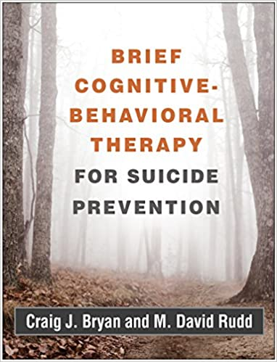
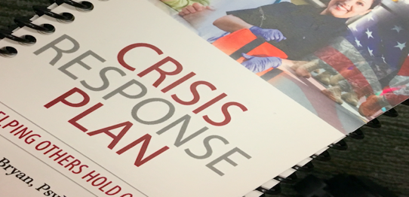
BCBT for SP
Describe an empirically-supported biopsychosocial model of suicide.
Effectively provide means restriction counseling to suicidal patients.
Understand common issues of confidentiality when working with military patients.
Effectively discuss with patients the risks of suicidal behavior both in and out of therapy as a routine part of informed consent.
Conduct a risk assessment interview in a manner that increases accurate & honest disclosure of suicidal ideation & behaviors.
Develop a written treatment and services plan that addresses suicide risk and is based on empirically-supported interventions.
Develop a written crisis response plan to reduce acute suicide risk.
Explain and administer a relapse prevention task for reducing suicidal behaviors.
Use cognitive strategies and interventions to undermine suicidal beliefs that contribute to suicidal behaviors.

Slide 5
Assessing and Managing Suicide Risk (AMSR)
July 29, 2020
9:00am - 4:30pm
Sheraton Milwaukee Brookfield Hotel 375 S. Moorland Rd. Brookfield, WI 53005
Assessing and Managing Suicide Risk: Core Competencies for Health and Behavioral Health Professionals AMSR is a one-day training (6.5 CEH’s) for behavioral health professionals based on the latest research and designed to help participants provide safer suicide care. Health care providers face many challenges when working with patients and clients at risk for suicide. Some patients may not disclose thoughts of suicide, and even when they do, the health care provider must make judgement calls about unpredictable outcomes, often with insufficient or contradictory information. This training will develop the five areas of competency for AMSR:
1. Approaching Your Work 2. Understanding Suicide 3. Gathering Information 4. Formulating Risk 5. Planning and Responding
Learning Objectives:
  Increased knowledge in the following core competencies: maintaining an effective attitude and approach, collecting accurate assessment information, formulating risk, developing a treatment and services plan, and managing care.
  Increased willingness, confidence, and clarity in working with individuals at risk for suicide.
  Increased ability to identify how they can better care for individuals at risk for suicide.
Trainer: Joanne Tulachka, MA, LPC, CSAC

Slide 6
Collaborative Assessment and Management of Suicidality (CAMS)
April 15 and 16, 2020
Virtual Experience via Zoom
CAMS is a clinical philosophy of care with a therapeutic framework for suicide-specific assessment and treatment of a patient’s suicidal risk. It is a flexible approach that can be used across theoretical orientations and disciplines for a wide range of suicidal patients across treatment settings and different treatment modalities. CAMS framework is guided by a multi-purpose clinical tool called the “Suicide Status Form” (SSF) which guides the patient’s treatment and includes:
  suicide-specific assessment,
  suicide-specific treatment planning,
  tracking of on-going risk, and
  clinical outcomes and dispositions
April 15 8:30am - 4:30pm (6.5 CEH’s)
Introduction to Suicidality and Collaborative Assessment and Management of Suicidality (CAMS) Care
April 16 8:30am – 5:00pm (7.0 CEH’s)
(CAMS) Experiential Role Play
Trainer: Dr. Jennifer Crumlish

