Slide 1
Zero Suicide Implementation Report
Erica Steib, MPH Candidate

Slide 2
The need
Implementation Report – Asks the questions: “What does ZS implementation look like in real life implementation? What have ZS trained organizations found successful and challenging to implement?”
Meant to guide further efforts to improve the ZS training
Not a formal evaluation – Not measuring outcomes or impact on suicide deaths
Notes:
-My field experience product for my MPH
-MHA-WI has not yet conducted an evaluation of ZS – so this is the first time anything of this nature has been done
-Implementation Report deliverable will be shared with DCTS

Slide 3
Methods
Qualitative data gathered through interviews via Zoom conference calls with representatives from ZS trained orgs
Thematic Analysis of interview content conducted to summarize challenges/successes and common themes
15 organizations participated
Organization Classification | Number of Participants
Hospital System | 5
Outpatient | 4
County HHS Department | 5
Other | 1
Notes:
Outreach to all ZS trained orgs began in October 2019 (with the exception of the 2019 Cohort) to ask if they would participate
ZS Faculty helped facilitate these interviews, lent their expertise and prior familiarity to ask follow-up questions and enrich the conversation
-15 organizations out of 47

Slide 4
INTERVIEW QUESTIONS
What have you implemented based on the ZS training?
  Is this still in place?
What have you noticed about this component?
  Do you see it as effective?
What has been most challenging to implement?
  Describe the barriers related to this challenge
What do you need in order to overcome these barriers?
How does your ZS implementation team cooperate to carry out the program?
How have you brought suicide prevention training to the rest of your staff?

Slide 5
INTERVIEW QUESTIONS
What, if anything, has changed about your policies and procedures regarding…
  Safety plans
  Care management plans
  Suicide risk assessment
  Evidence-based interventions
  Care transitions
  Data collection
  Repeat of organizational self-study
  ZS workforce survey
How do you track whether those policies and procedures are reflected in staff practice?

Slide 6
Methods continued
Thematic analysis involves identifying, analyzing, and interpreting patterns of meaning (“themes”) from qualitative data
Conversations were recorded, transcribed to Word, then analyzed with NVIVO software

Slide 7
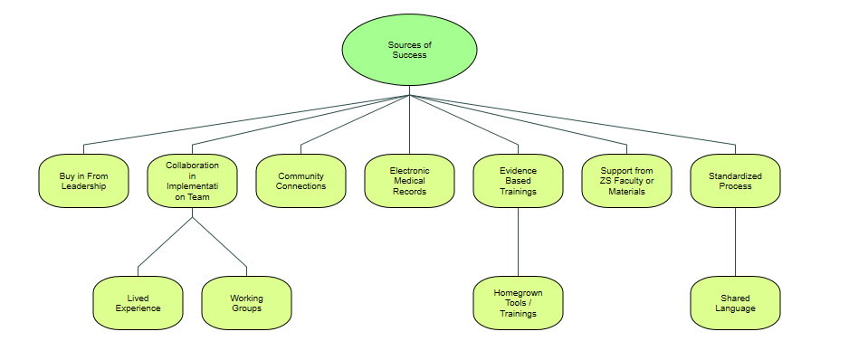
Sources of success
Notes:
-Enthusiastic buy in from leadership helped facilitate the changes (esp when leadership joined the Implementation Team)
-Interdepartmental collaboration on implementation team, plus including someone with lived experience
-Some orgs choose to divide into smaller working groups within their implementation team, which helps them stay organized
-Many orgs are connected with their County Coalitions and work to bring suicide care trainings to law enforcement, public health departments
-Standardized processes helps when the whole org accepts it
-Utilizing EMRs was helpful to embed procedures into the care routine, also tracking
**Some orgs identified EMRs as a major challenge – so this could indicate success with EMRs will depend on the degree of support available

Slide 8
Quotes
“We did that online learning module to introduce ZS as a concept, but we also pulled out some of that important learning that someone would learn in QPR. Like what the appropriate terminology is, what words to get rid of, what appropriate words we ought to be using. Like we talked about how saying “successful suicide” is not okay. We started talking about what you should be looking for if you were concerned about someone. We have an Ask Listen Act acronym, Ask are you struggling with anything? Are you feeling suicidal? Listen to what they say. Then take Action and based on our suicide policy, we identify what that is. We embed that in our online module. Which every person employed within our market, not system wide, had to take this calendar year. So they got live, in-person QPR and the online module”
  -Hospital system
Notes:
-Organizations get creative in the ways they bring ZS goals to the rest of the system
This org created their own online module to introduce ZS to the entire staff

Slide 9
QUOTES
“They are put on what is called the Care Pathway in our system and we are able to identify that they are higher risk, that helps other providers know that they should be asking safety questions and screening the for suicide. Primary care and any other external providers that have access to our electronic medical record chart. We even made a video on what it means to be on a care pathway. And to be identified one someone’s safety plan.
The video went out to school staff, cause we’ve tried hard to loop schools into this process because they see these kids 30 hours a week or whatever. To have them connected and to be support and another tool or resource for our clients to reach out to for support and assessment.
We had our safety plan where kids could identify other adults they could turn to. We got calls from people who were identified, and they said, I don’t know what to do? I don’t know, what does that mean to me? And we thought that was a really great point, to show up on someone’s list, and then they show up with a safety plan, like hey I saw my therapist today and here’s my safety plan, that can bring up anxieties in teachers and other people. So that’s why we created the video.”
Notes:
-Outpatient mental health provider
-Educational video for adults and caregivers identified in a child’s care pathway

Slide 10
Quotes
“I appreciate the language that allows a hopeful message while removing shame and blame or guilt for survivors of suicide when they come into contact in these talks. That’s a little feedback from me. I really like the theoretical framework of ZS and the framework provides an opportunity to have difficult conversations sometimes.”
  -Outpatient mental health provider
Notes:
-Shared language and community within ZS helps make the work more tangible
-Support from ZS faculty, listserv, and other online resources described as helpful

Slide 11
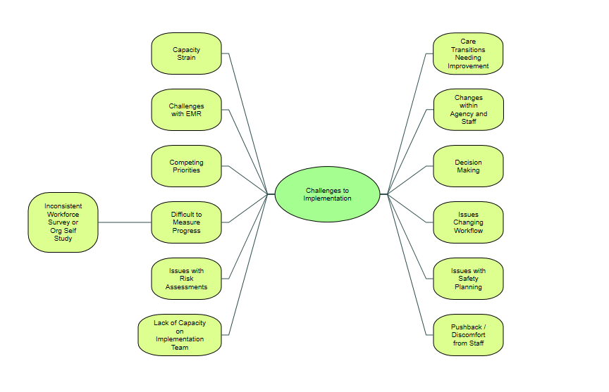
Challenges/barriers
Notes:
-competing priorities make it difficult to get the support
-many layers of decision making also slow down progress
-Capacity strain as a general barrier included strain on time, financial resources, and personnel resources
-Lack of capacity within the implementation team was an issue for some organizations where staff turnover left very few people
Optimizing electronic medical records can also be a challenge
For risk assessments and safety planning, challenges were related to consistent use of the Colombia and Stanley-Brown safety plan, even when they became the established standard. In some instances, clinicians who see the same clients very regularly felt the pace of use was redundant and awkward
Warm hand-offs can be difficult when different institutions are not using the same electronic medical records or releasing information
Most of the organizations interviewed struggled with formally tracking progress and change
Every participant recalled doing the workforce survey and organizational self-study at least one time, but many were not repeating these studies regularly or with consistent structure

Slide 12
QUOTES
“Really the positive reframe is if we get our system organized and use evidence-based practice, we can have a safer system. They can get on board with that. There’s been pushback on the term “zero suicide” and the negative frame of that. That what we’re doing leads to negative outcomes and that we don’t already have a safe system.”
Notes:
Even though many organizations did not struggle to get their colleagues to understand why suicide prevention matters, some representatives mentioned pushback and discomfort as a minor challenge to work with. There is the usual pushback that comes with changing any aspect of workflow and procedure. There was also some pushback to the framework of Zero Suicide, as in some degree of fear that the health care provider would be blamed in the event of suicide.

Slide 13
IDEAS FOR FURTHER SUPPORT
“When I went to the training, we were given an operational approach. As you all know, it’s a tremendous amount of work to make that real. To take it from an idea to somebody entering a safety plan into the medical record. I think before we actually put a plan together maybe it would be helpful to have faculty review, who have done it before, give some technical assistance.”
  -County health department
Notes:
some organizations would appreciate more structured mentorship from Zero Suicide faculty

Slide 14
PROJECT LIMITATIONS
Findings are specific to the sample and do not demonstrate the overall impact of the ZS program on suicide prevention
15/47 organizations participated – still too small to make generalizations about the experiences of ALL ZS trained orgs in WI
More time available would allow for more extensive data collection and more complex data analysis
Incentives should be offered to ZS trained orgs for their participation
Notes:
It is possible that the organizations who did not respond to the initial outreach are struggling under capacity strain, which will certainly impact how much of the framework they have been able to implement
There may be fundamental differences between the organizations who participated and those who did not
To conduct a more thorough evaluation of the program, MHA-WI should work with evaluators outside of the organization to minimize bias in analysis

Slide 15
conclusion
Degree of success varied depending on buy-in from the organization as a whole and available resources, including financial, personnel, and technological capacity
Size and composition of implementation team can influence the depth of work accomplished
ZS offers standardized processes and shared language
Organizations may need additional mentoring/assistance from ZS faculty
Concerns related to procedural difficulties, EMRs are an opportunity for improvement

